Slide 1
Design Verification
Personal Software ProcessSM for Engineers: Part II

Slide 2
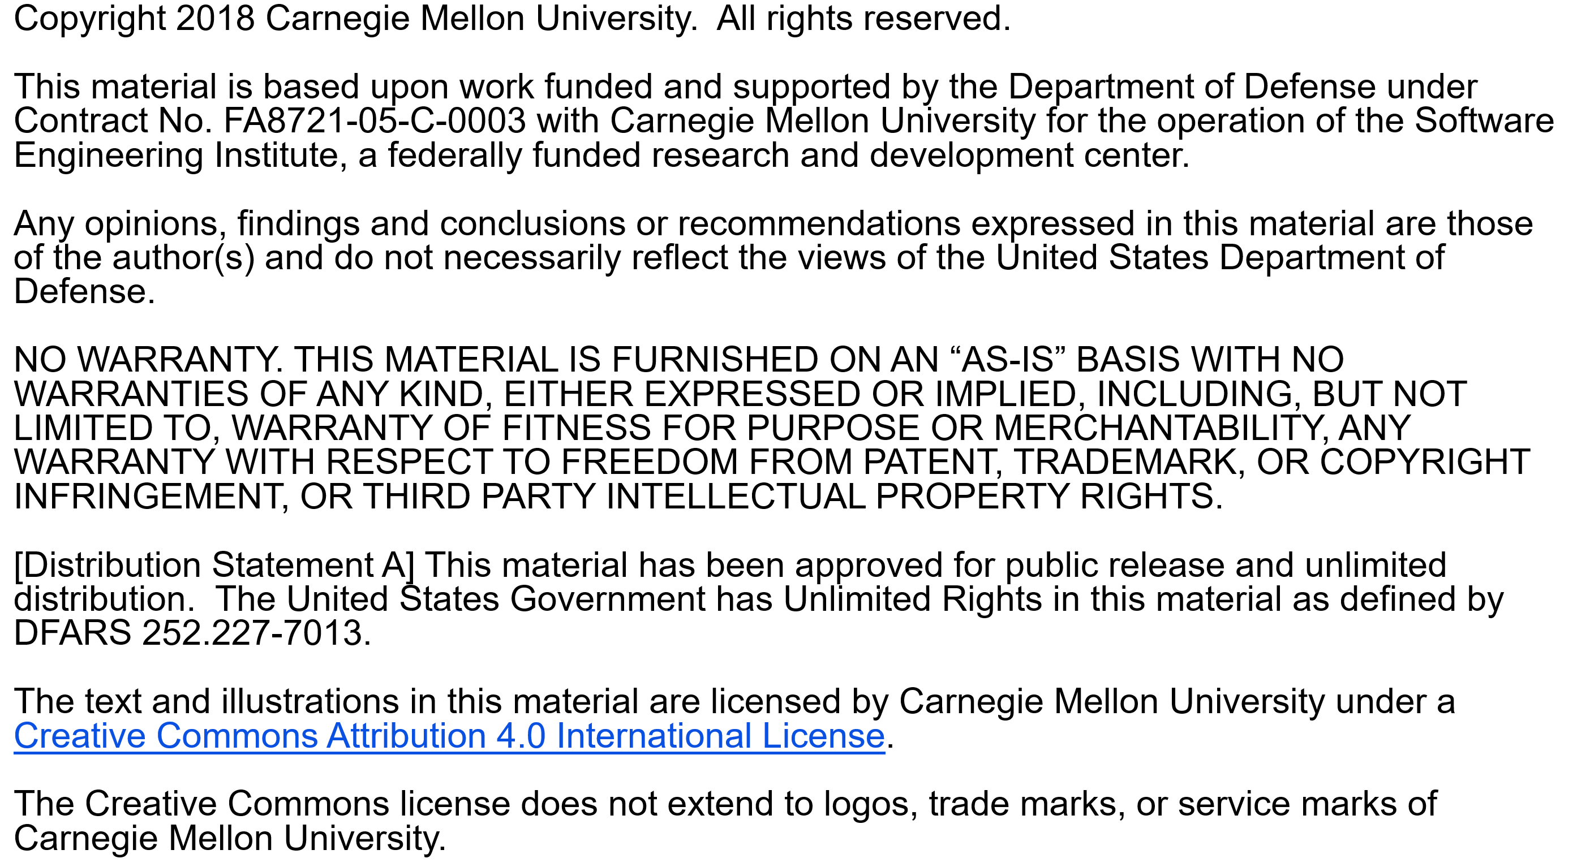

Slide 3
Copyright 2017 Carnegie Mellon University [Distribution Statement A] This material has been approved for public release and unlimited distribution. Please see Copyright notice for non-US Government use and distribution. This material is based upon work funded and supported by the Department of Defense under Contract No. FA8721-05-C-0003 with Carnegie Mellon University for the operation of the Software Engineering Institute, a federally funded research and development center. NO WARRANTY. THIS CARNEGIE MELLON UNIVERSITY AND SOFTWARE ENGINEERING INSTITUTE MATERIAL IS FURNISHED ON AN “AS-IS” BASIS. CARNEGIE MELLON UNIVERSITY MAKES NO WARRANTIES OF ANY KIND, EITHER EXPRESSED OR IMPLIED, AS TO ANY MATTER INCLUDING, BUT NOT LIMITED TO, WARRANTY OF FITNESS FOR PURPOSE OR MERCHANTABILITY, EXCLUSIVITY, OR RESULTS OBTAINED FROM USE OF THE MATERIAL. CARNEGIE MELLON UNIVERSITY DOES NOT MAKE ANY WARRANTY OF ANY KIND WITH RESPECT TO FREEDOM FROM PATENT, TRADEMARK, OR COPYRIGHT INFRINGEMENT. This material is distributed by the Software Engineering Institute (SEI) only to course attendees for their own individual study. Except for the U.S. government purposes described below, this material SHALL NOT be reproduced or used in any other manner without requesting formal permission from the Software Engineering Institute at permission@sei.cmu.edu. The U.S. Government's rights to use, modify, reproduce, release, perform, display, or disclose this material are restricted by the Rights in Technical Data-Noncommercial Items clauses (DFAR 252-227.7013 and DFAR 252-227.7013 Alternate I) contained in the above identified contract. Any reproduction of this material or portions thereof marked with this legend must also reproduce the disclaimers contained on this slide. Although the rights granted by contract do not require course attendance to use this material for U.S. Government purposes, the SEI recommends attendance to ensure proper understanding. PSPSM, Team Software ProcessSM and TSPSM are service marks of Carnegie Mellon University. DM-0004449

Slide 4
Lecture Topics
This lecture provides a survey of several design verification topics.
reasons for design verification
design verification methods
symbolic execution
execution tables
case checking and trace tables
correctness verification
Practice is required to consistently and effectively use these verification techniques.

Slide 5
Need for Design Verification -1
It is hard to eliminate many design defects just by making process changes.
Checklists and a structured review process can improve code-review yield.
Design reviews with checklists are also helpful, but not sufficient.
A checklist item, “Is module logic correct?” cannot be confirmed by scanning the specification templates.

Slide 6
Need for Design Verification -2
To improve design-review yield, you must use disciplined verification methods.
An orderly approach to design verification is essential because
many common design defects are caused by overlooked conditions
situations that seem unlikely become more likely with complex systems and high-powered computers
conditions that were initially impossible may be likely after a program is modified

Slide 7
Benefits of Design Verification
By following a structured design verification procedure, you are more likely to
see overlooked conditions
identify rarely-exposed risks
recognize possible future exposures
By recording information during each design review, you can improve the effectiveness of later design inspections.

Slide 8
Using Design Verification
Design verification methods should be used during
design
design reviews
design inspections
Verifying designs with source-code is time-consuming and error-prone.
Use design verification methods to focus on the defect types that cause you the most trouble in test.
Use your data to decide which verification methods are most effective for you.

Slide 9
Symbolic Execution -1
With symbolic execution
the program is represented symbolically
program behavior is examined analytically
Though not always practical, symbolic execution can produce a comprehensive verification.
The approach is to
assign algebraic symbols to the program variables
restate the program as one or more equations using these symbols
analyze the behavior of the equations

Slide 10
Symbolic Execution -2
Some questions to ask are
Does the program converge on a result?
Does the program behave properly with both normal and abnormal input values?
Does the program always produce the desired results?

Slide 11
Symbolic Execution Example -1
Examine the following program segment.
What would be the result for various values of X and Y ?
Note: This simple example merely illustrates how symbolic execution can reveal non-obvious functionality.

Slide 12
Symbolic Execution Example -2
The program steps for this example are as follows.
The result for inputs A and B is B and A.

Slide 13
Symbolic Execution: Assessment
Advantages: symbolic proofs
can be general
typically involve less work than other methods
are sometimes the only practical way to do a comprehensive verification
Disadvantages: symbolic execution
is hard to use, except for algorithmic and substitution problems
proofs are manual and error-prone
is difficult to use with complex logic

Slide 14
Execution Tables -1
An execution table is an orderly way to trace program execution.
It is a manual check of program flow.
It starts with initial conditions.
A set of variable values is selected.
Each execution step is examined.
Every change in variable values is entered.
Program behavior is checked against the specification.

Slide 15
Execution Tables -2
The advantages of execution tables are that they
are simple
give reliable results
The disadvantages of execution tables are that they
check only one case at a time
are time-consuming
are subject to human error

Slide 16
Execution Table Procedure
To use an execution table
identify the key program variables and enter them at the top of the table
enter the principal program steps
determine and enter the initial conditions
trace the variable values through each program step
use additional execution-table copies for each cyclic loop

Slide 17
Execution Table Exercise
In the Design Verification Exercise (found in the File Repository below), use the execution table to verify the correctness of the LogIn program.
Check a two-cycle scenario:
Valid ID & !Valid PW
ID timeout error & Valid PW.
Assume nMax = 3.
Pair up and take 20 minutes to do the verification. Blank execution tables are in the notebook.
20 minutes

Slide 18
LogIn Execution Table -1

Slide 19
LogIn Execution Table Discussion
The program has an error.
Since the design does not require ID to be set to !Valid on a new cycle, the implementation could result in an error.
In the second cycle, a Valid PW could end the test with ID = Valid, PW = Valid, and Fail = true.
Depending on implementation, this design omission could result in an incorrect login.

Slide 20
LogIn Execution Table -2

Slide 21
LogIn Execution Table -3

Slide 22
Case Checking
Case checking involves the following five steps.
Examine the program to determine its behavior categories.
For these categories, identify the cases to check.
Check the cases to ensure that they cover all possible situations.
Examine program behavior for each case.
Once every case has been verified, program behavior has been verified.

Slide 23
Trace Tables
Trace tables are similar to execution tables, but more general.
Trace tables examine general program behavior, rather than verifying individual cases.
Trace tables use
symbolic execution
case checking

Slide 24
Trace Table Procedure
The trace table procedure is the same as that for the execution table, plus three steps.
Identify the key program variables and enter them at the top of the table.
Enter the principal program steps.
Identify symbolic execution possibilities.
Define all of the possible cases and select those to check.
Determine and enter the initial conditions.
Trace the variable values through each program step.
Use additional trace-table copies for each cyclic loop.
For multi-cycle loops, group intermediate steps if their results are obvious.

Slide 25
Trace Table Example
The ClearSpaces routine clears leading and trailing spaces from an input string and sets the value of state.
The following example omits the Length = 0 test and clears trailing spaces. It is in the textbook, Table 12.5 (page 264).

Slide 26
Trace Table Cases -1
The symbolic execution parameters are as follows.
string length: Length > 0
leading spaces: L
non-space characters: N
trailing spaces: T
The possible cases are
L or N or T = 1 while the others = 0
L or N or T > 1 while the others = 0
L or N or T = 0 while the others > 0
L and N and T > 0

Slide 27
Trace Table Cases -2
A comprehensive test would check all cases.
It would also check for any limitations on the upper limit values of L, N, and T.
A common trace-table strategy is to pick a specific set of values for each case and then generalize the result.
The following example for trailing spaces shows the approach with L and N and T > 0.

Slide 28
Trailing Space Example -1
Cycle 1: L = 1, N = 2, T = 1
ClearSpaces(var Input: string; State: int)
#
Instructions
Condition
Input
Length
State
1
Length := length(Input) State := 0
‘ AB ‘
4
0
2
repeat
3
if Input[Length] = ‘ ‘
4
Length := Length - 1
5
if State < 2 State:=State+1
6
else State := 3
until State=3 or Length=0

Slide 29
Trailing Space Example -2
In using a trace table, it is essential to determine precisely what the computer would do for each step.
In this example, the value of Input[Length] is indeterminate because the last character of the string is at Length - 1.
This is a defect.
After correcting this defect, the trace table is as shown in the next slide.

Slide 30
Trace Table Example: Cycle 1
Cycle 1: L = 1, N = 2, T = 1
ClearSpaces(var Input: string; State: int)
#
Instructions
Condition
Input
Length
State
1
Length := length(Input) State := 0
‘ AB ‘
4
0
2
repeat
3
if Input[Length-1] = ‘ ‘
true
4
Length := Length - 1
3
5
if State < 2 State:=State+1
true
1
6
else State := 3
7
until State=3 or Length=0
false

Slide 31
Trace Table Example: Cycle 2
Cycle 2: L = 1, N = 2, T = 1
ClearSpaces(var Input: string; State: int)
#
Instructions
Condition
Input
Length
State
1
Length := length(Input) State := 0
2
repeat
‘ AB ‘
3
1
3
if Input[Length-1] = ‘ ‘
false
4
Length := Length - 1
5
if State < 2 State:=State+1
6
else State := 3
3
7
until State=3 or Length=0
true

Slide 32
Trace Table Discussion
First, carefully check the initial conditions to ensure that they are set by the program.
Second, double-check the trace table for errors and omissions.
Then, after completing each case, check behavior for different parameter values.
For example, the State := 3 step for the trace-table case with T trailing spaces, is shown on the next slide.

Slide 33
Trace Table Example: Cycle T
Cycle T: L = 1, N = 2, T = T
ClearSpaces(var Input: string; State: int)
#
Instructions
Condition
Input
Length
State
1
Length := length(Input) State := 0
2
repeat
‘ AB…’
3
2
3
if Input[Length-1] = ‘ ‘
false
4
Length := Length - 1
5
if State < 2 State:=State+1
6
else State := 3
3
7
until State=3 or Length=0
true

Slide 34
Verifying Program Correctness
Correctness verification methods treat programs as mathematical theorems.
These methods are particularly useful during design and design review.
Because program verification often involves sophisticated reasoning, it is important to check your work carefully.

Slide 35
Correctness Verification
To verify a program
identify all of the program cases
consider each verification question while reviewing each non-trivial construct
where the answer is not obvious, use a trace table to evaluate the conditions that the program must satisfy
While this verification approach works with most design constructs, only “while loops” are described in this lecture.
Proofs for repeat-until and for-loops are described in the textbook (pages 271 - 277).

Slide 36
WhileLoop Verification -1
The WhileLoop is assumed to have the following form.

Slide 37
WhileLoop Verification -2
A while-loop is correct if all of the following questions can be answered with “yes.”
Question 1: Is loop termination guaranteed for any argument of WhileTest?
Question 2: When WhileTest is true, does WhileLoop = LoopPart followed by WhileLoop?
Question 3: When WhileTest is false, does WhileLoop = identity?

Slide 38
WhileLoop Example -1
Assuming n > 0, calculate n!

Slide 39
WhileLoop Example -2
Question 1: Is loop termination guaranteed for any argument of WhileTest?
Yes, the loop terminates when i = n. Since i steps inside the loop, it will terminate as long as n > 0.
Question 2: When WhileTest is true, is WhileLoop = LoopPart followed by WhileLoop?
Yes, the LoopPart increments i and sets f equal to f * i, so f is still equal to i!
Note: The initial conditions ensure that f = i! initially.

Slide 40
WhileLoop Example -3
Question 3: When WhileTest is false, does WhileLoop = identity?
Yes, when WhileTest is false, the loop terminates without further changes to any variables, so i = n and f = i!
Hence, we can deduce that f = n! as required.

Slide 41
Another WhileLoop Example -1
Given a value x and an array a[0 .. n-1] that is sorted in ascending order, verify that the following binary search algorithm finds the smallest index i such that x ≤ a[i].

Slide 42
Another WhileLoop Example -2
The informal specification is incomplete.
What should happen if n = 0 (empty array)?
What should happen if x > a[n-1]?
We can formalize the specification as:
So
if x > a[n-1] then the desired result is i = n
if n = 0 then the desired result is i = 0

Slide 43
Another WhileLoop Example -3
To use case checking, we should consider cases when
x is equal to the first element of the array
x is equal to any intermediate element of the array
x is equal to the final element of the array
x is not equal to any element
Here, we look at x is not equal to any element.
Let the array a = <2, 3, 5, 7> with n = 4 and x = 4.

Slide 44
The WhileLoop Trace Table

Slide 45
Verification Discussion
The algorithm fails to terminate for this set of inputs.
A trace table will reveal design defects, but it does not suggest how to fix them.
The algorithm correction is to replace i = k with i = k + 1.
With this change, the next step would be to answer the three WhileLoop questions, with a trace table if necessary.

Slide 46
Comments: Program Verification
If done correctly, these verification methods can guarantee program correctness.
Mastery of these verification methods requires skill and practice.
The loop termination test is critical because endless loops are hard to identify with other methods.
While you can often answer the verification questions by inspection, when in doubt, check the results with a trace table.

Slide 47
UML and Verification -1
Graphical designs can be difficult to verify and often require special care.
UML diagrams can and should be checked for consistency.
The names of all classes, operations, and attributes should also be defined and used consistently.
UML state charts can be verified as shown before, but the state and transition conditions must be explicit.

Slide 48
UML and Verification -2
Execution in UML sequence diagrams can be traced if the diagrams are sufficiently detailed.
Similarly, every message sent between objects must be supported by a traversable link defined in a class diagram.
Some UML tools can simulate execution of UML models, but these tools should be used only after other review techniques.

Slide 49
Messages to Remember
You will significantly improve your design-review yield by using disciplined design review methods.
With complex programs, the time spent verifying designs will be more than repaid by the testing time saved.
Practice using verification techniques and then select the most effective ones for finding the defects that you most commonly find in testing.

